Slide 1

Final Project BDAT 1001
Subject : Information Coding Standards
Topic : User Data Protected By Authorization
Students : Namrakumar Patel (200535046)
Nikita Nikita (200557996)
Pankaj Mehta (200547613)
Ankit Lehra(200556803)

Slide 2
Project Summary
In a web application, user data can be protected by authorization through various mechanisms, such as authentication, access control, and permissions.
Authentication is the process of verifying the identity of a user, typically through a username and password or other forms of credentials. Once the user is authenticated, the web application can grant them access to specific resources based on their roles or permissions.
Overall, a well-designed authorization mechanism can help ensure that only authorized users have access to sensitive data in a web application, helping to protect against unauthorized access, data breaches, and other security risks

Slide 3




MEET OUR TEAM
Nikita NIKITA
Ankit Lehra
Degree: Bachelor in Computer Engineering
Experience: 1 year as full stack developer.
Degree : Computer Engineering, Artificial Intelligence
Experience : 2 Years as Full stack developer
Pankaj Mehta
Namra Patel
BTech in Instrumentation and Control Engineering
Graduate in Computer Application

Slide 4
Introduction
implementing authentication and authorization using ASP.NET Core Identity, SQL Server, and Entity Framework.
installing necessary dependencies, configuring the middleware, creating a database, and seeding user roles using Entity Framework.

Slide 5


Apps and Technology Applied
Apps: Visual Studio 2022, SQL Server Management Studio, Postman, Microsoft Edge Browser
Programming Languages : C# and SQL

Slide 6
Step 1: Using ASP.NET Core Identity
need to manage authentication and authorisation to restrict user access to the certain resources.
Authentication means being able to recognise the user that is trying to log into the site, whereas authorisation means being able to manage the permissions that a user has to access certain resources.

Slide 7
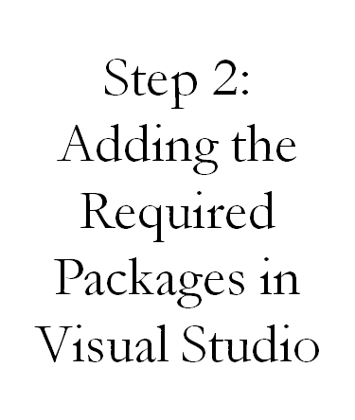
Microsoft.EntityFrameworkCore.SqlServer
Microsoft.EntityFrameworkCore.Tools Microsoft.AspNetCore.Identity.EntityFrameworkCore
Microsoft.EntityFrameworkCore.Tools
Microsoft.VisualStudio.Web.CodeGeneration.Design
Microsoft.AspNetCore.Identity.UI

Slide 8

Step 3 : Create owner, manager and administrator authorization handlers
The ContactIsOwnerAuthorizationHandler verifies that the user acting on a resource owns the resource.
The ContactManagerAuthorizationHandler verifies the user acting on the resource is a manager. Only managers can approve or reject content changes (new or changed).
The ContactAdministratorsAuthorizationHandler verifies the user acting on the resource is an administrator. Administrator can do all operations.

Slide 9
Step 4:Register the authorized handlers
The ContactISOwnerAuthorizationHandler uses ASP.NET Core Identity, which is built on Entity Framework Core.
Register the handlers with the service collection so they are available to the Contacts Controller through dependency injection.

Slide 10
Step 5: Inject the authorization service into the views
The UI shows edit and delete links for contacts the user can’t modify.
Update the EDIT and Delete links in Pages/contacts/Index.cshtml so they are only rendered for users with the appropriate permissions.
Update the details view so managers can approve or reject contacts.

Slide 11
Step 6: Add or remove a user to a role
Removing Privileges from a user.
Adding Privileges to a user.
When the user is authenticated , but not authorized, a ForbidResult is returned. When a ForbidResult is returned, the user is redirected to the access denied page.
After that, Choose a strong password for at least one upper-case character, number, and symbol.
Execute the following command from the project’s folder, where <pw> is password.

Slide 12
Create the starter app
Create a Razor Pages app named “Contact Manager”.
Create the app with Individual User Accounts.
Name it “ContactsManager” so the namespace matches the namespace used in the sample.
Add Models/CONTACTS.CS: secure- data\samples\starter6\ContactManager\Models\Contact.cs.
Scaffold the contact model.

Slide 13
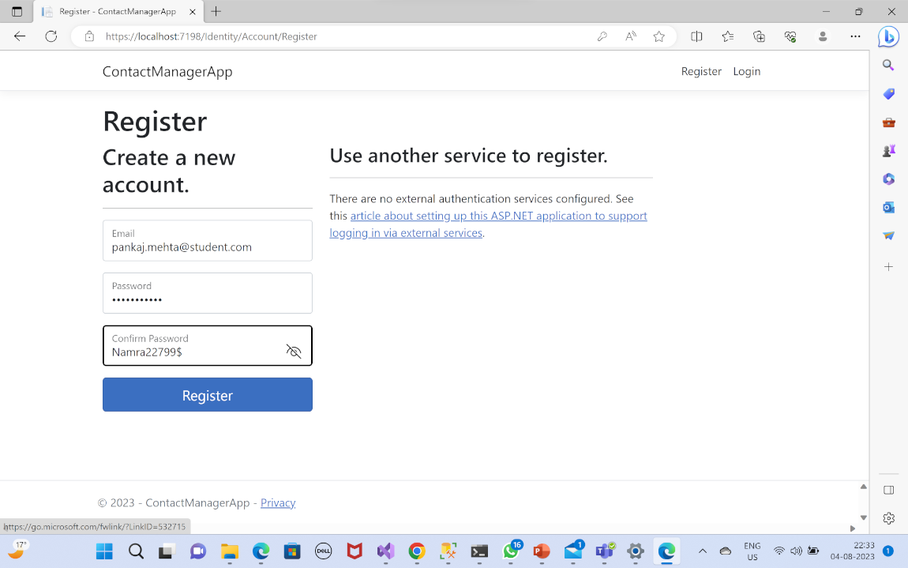
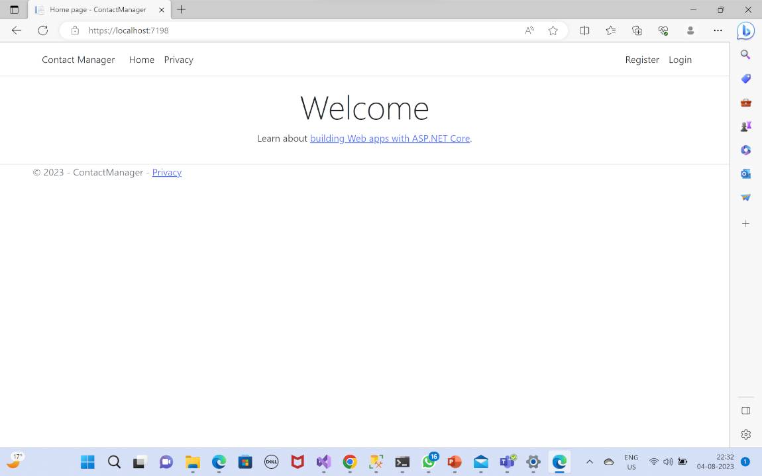
Screenshots Of The Web App

Slide 14
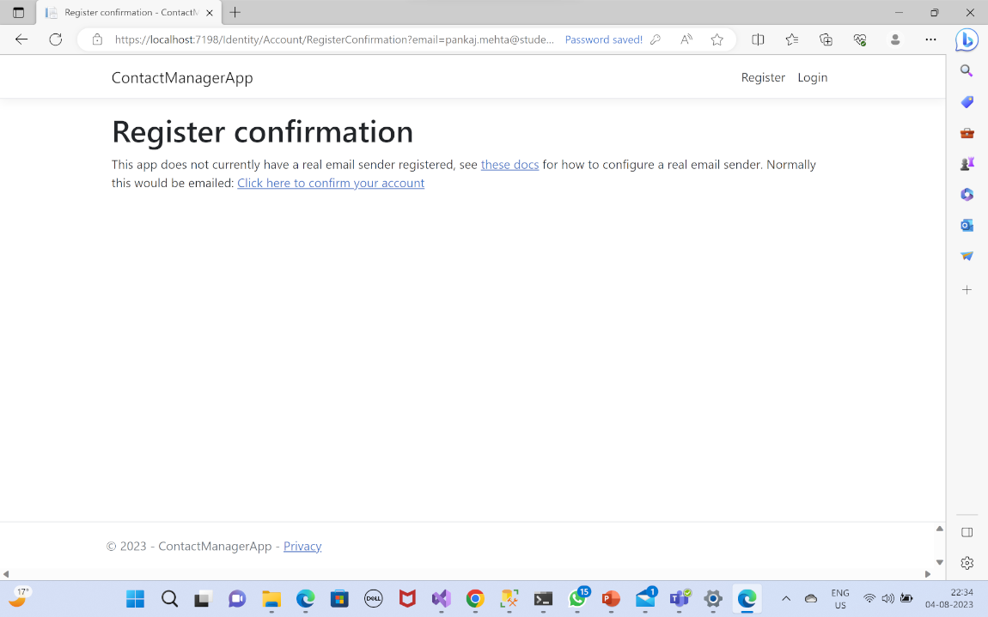
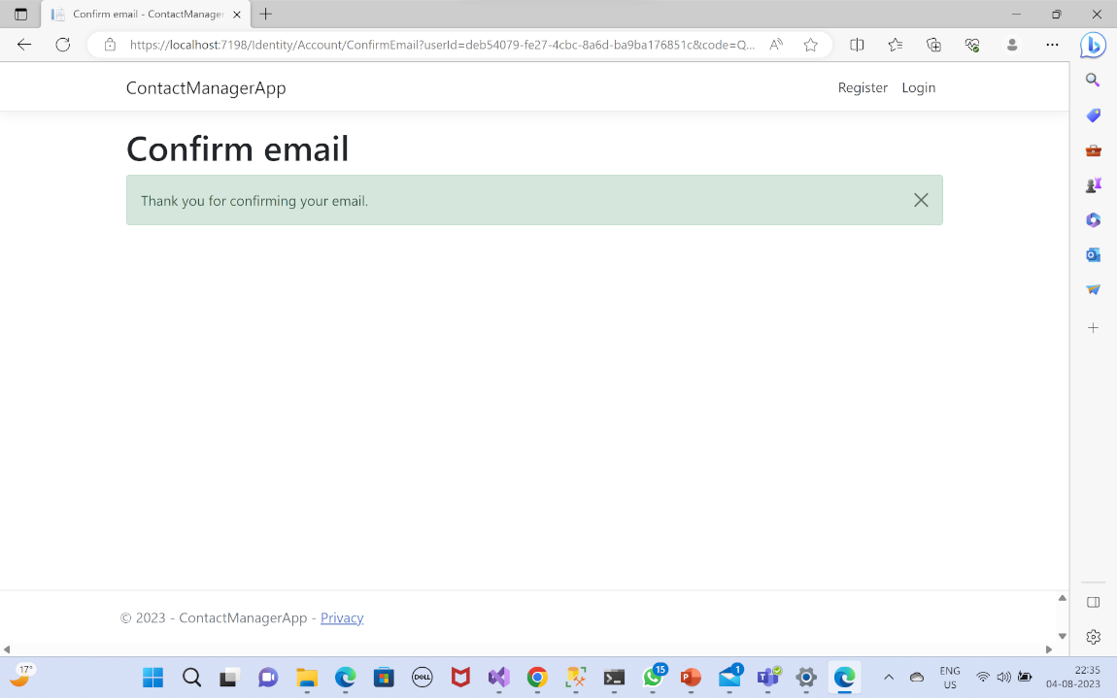
User Registration

Slide 15
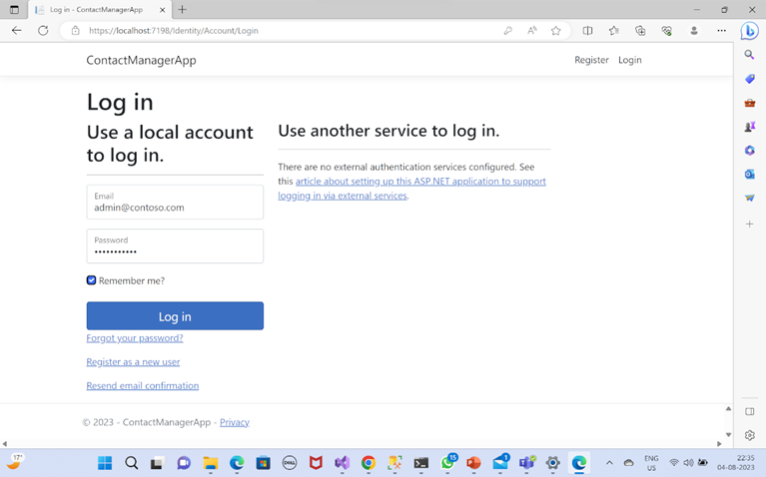
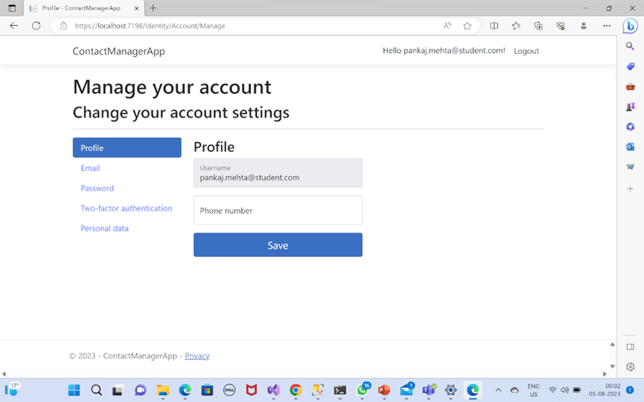
Login Page & User Edit

Slide 16
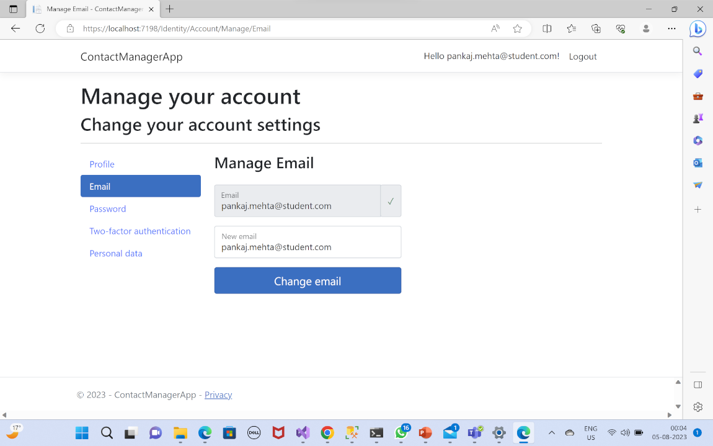
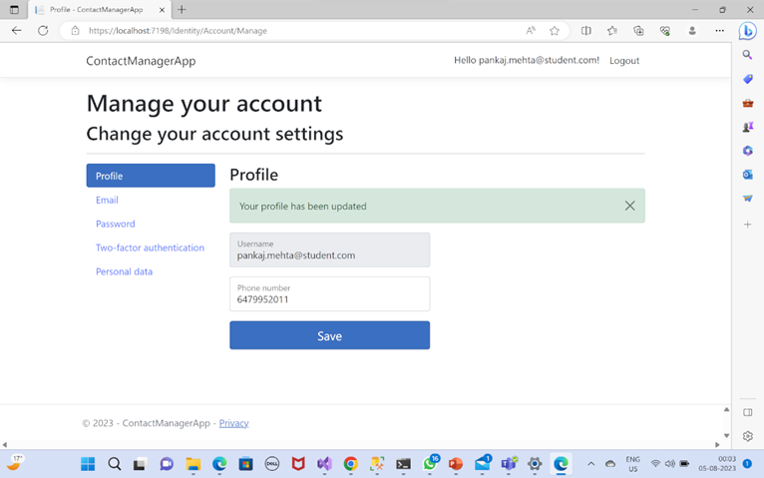
User Edit

Slide 17
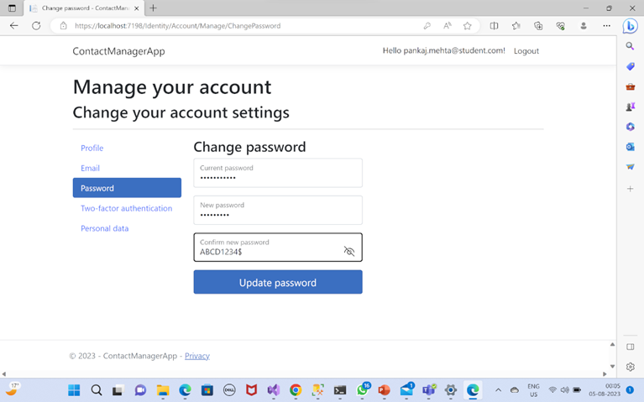
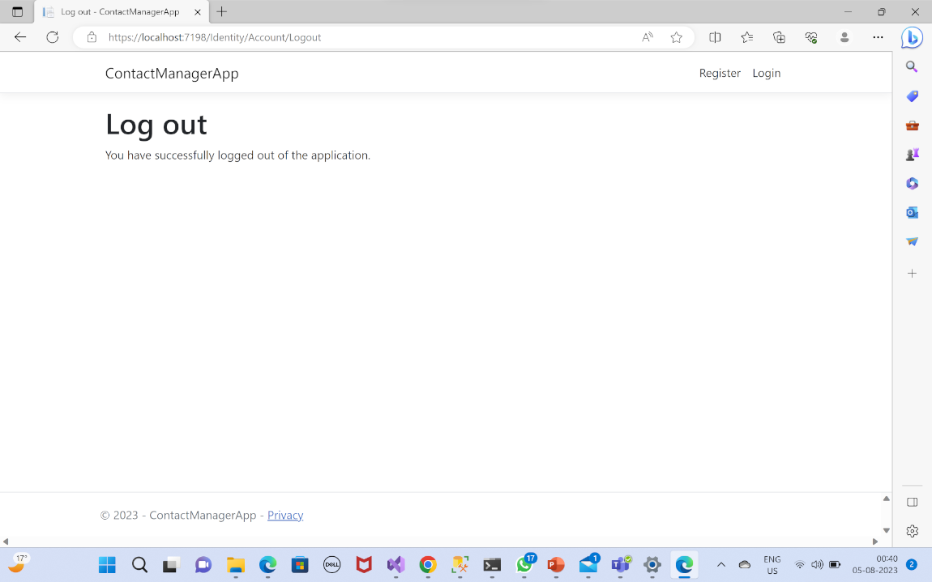
User Edit & Logout

Slide 18
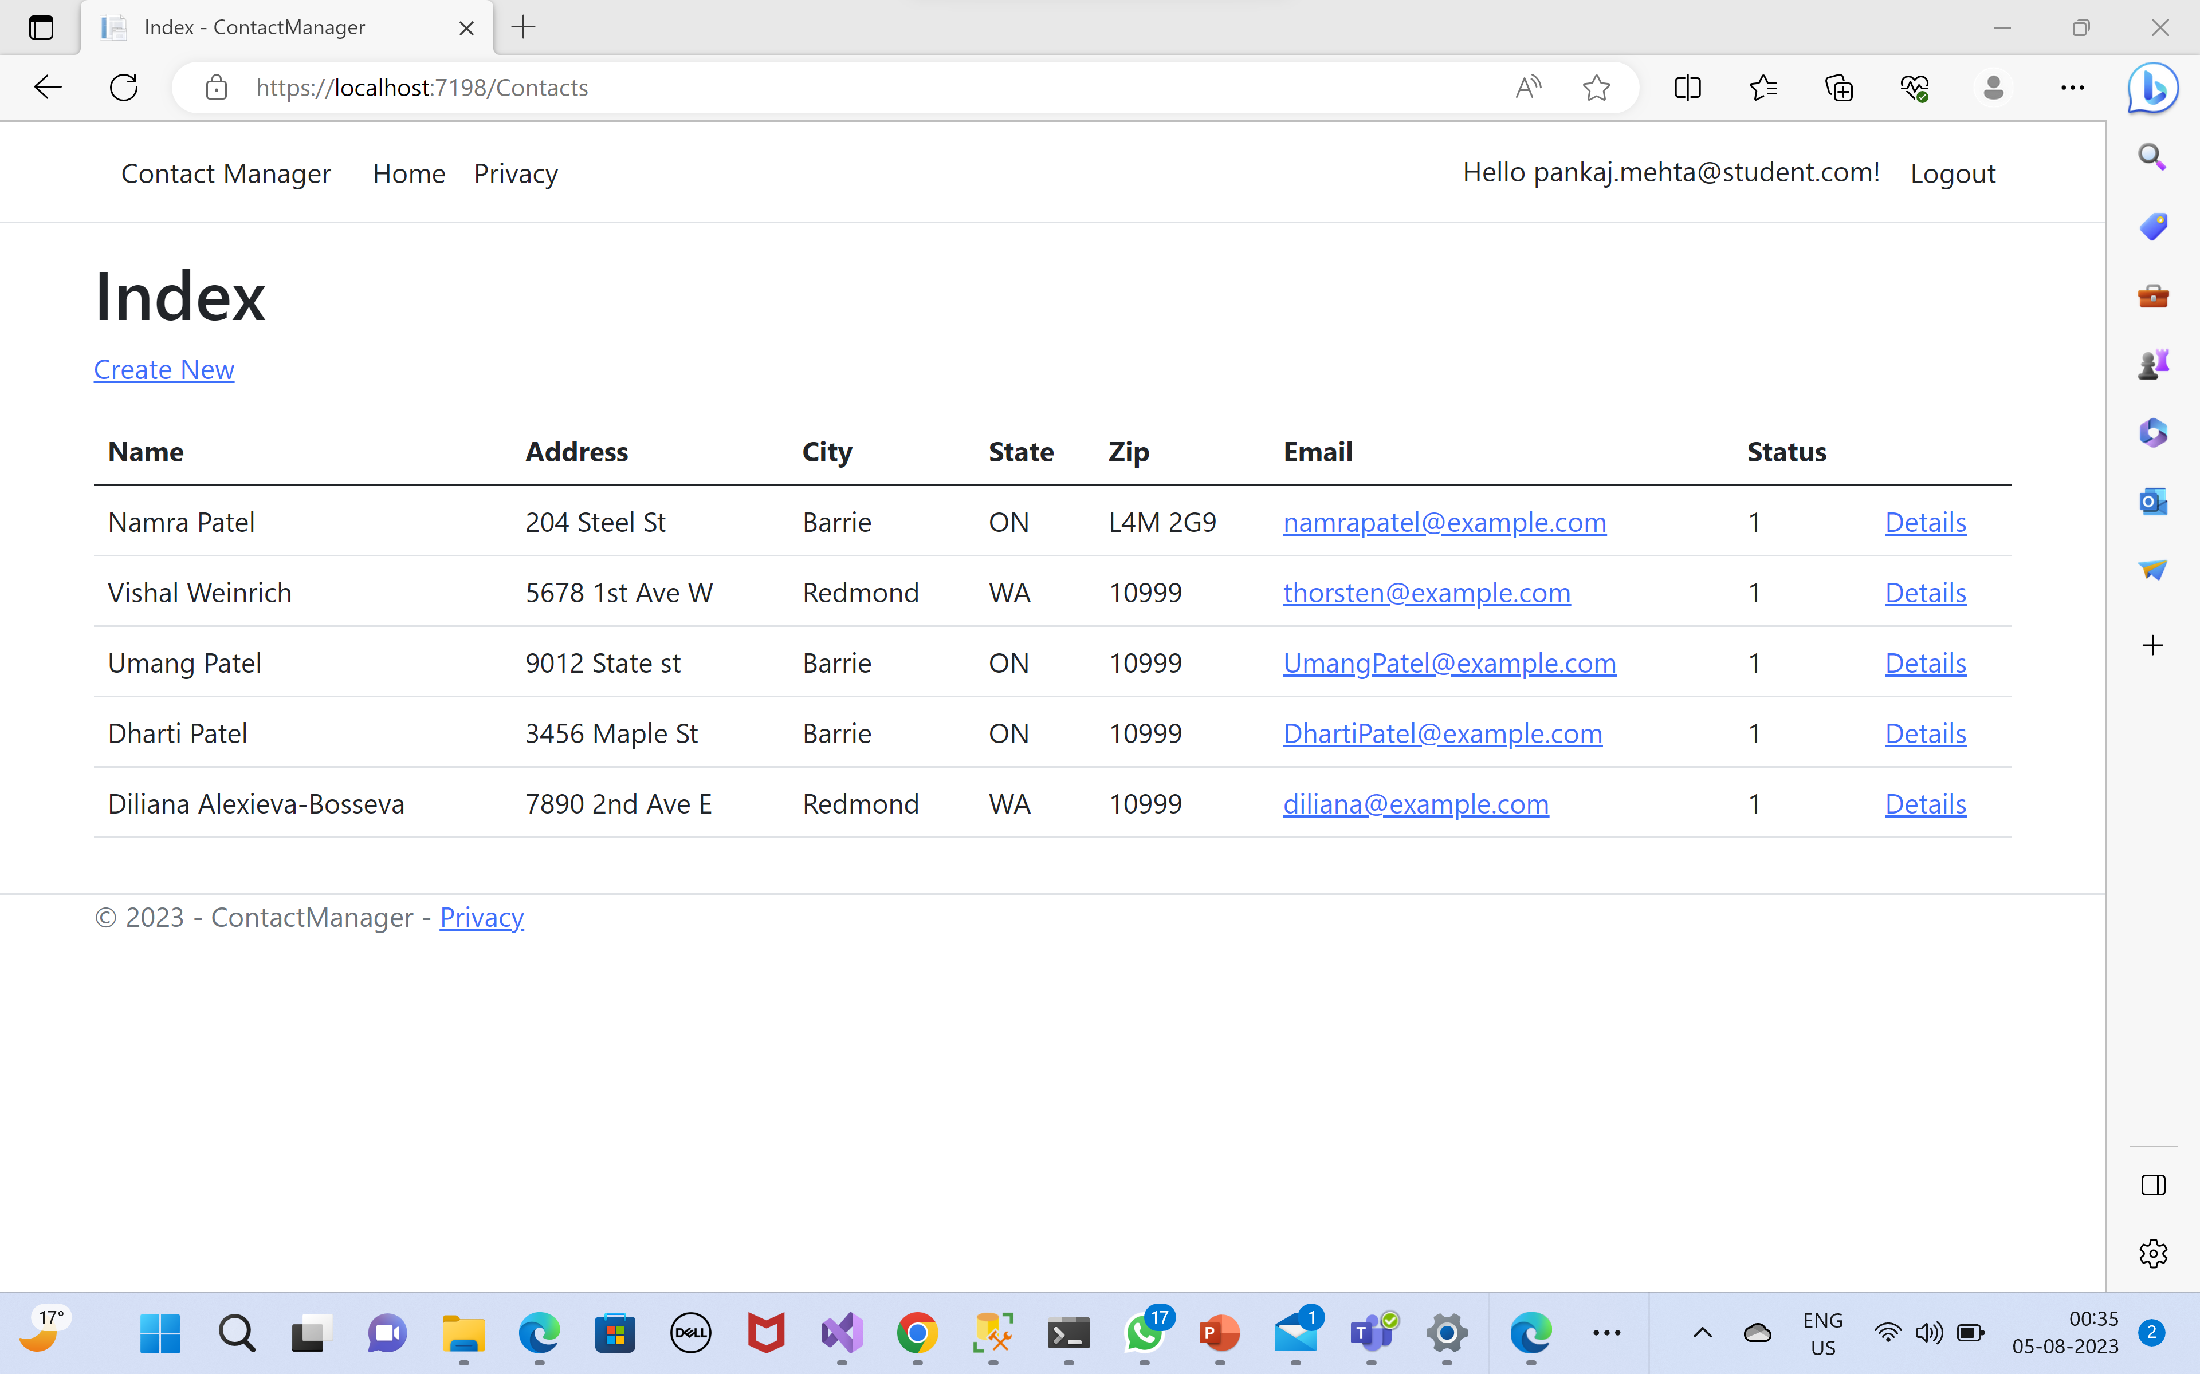
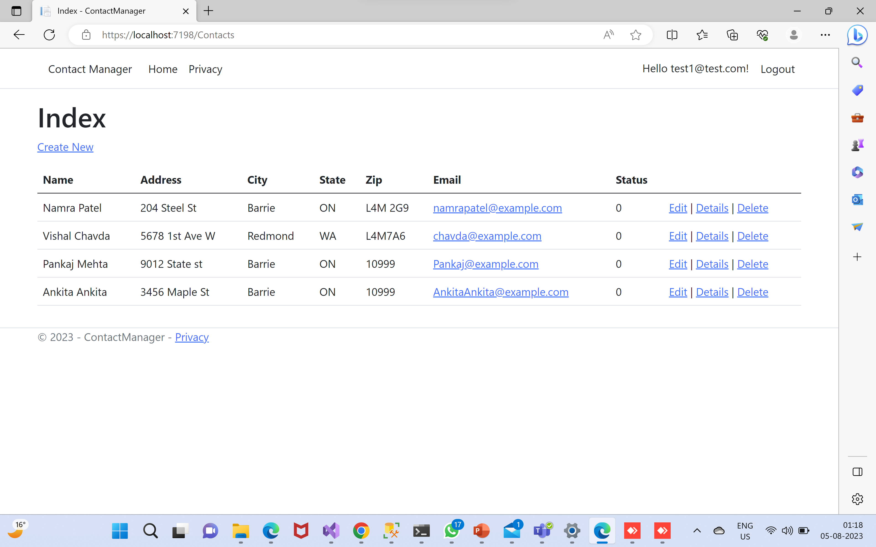
Contact Pages

Slide 19
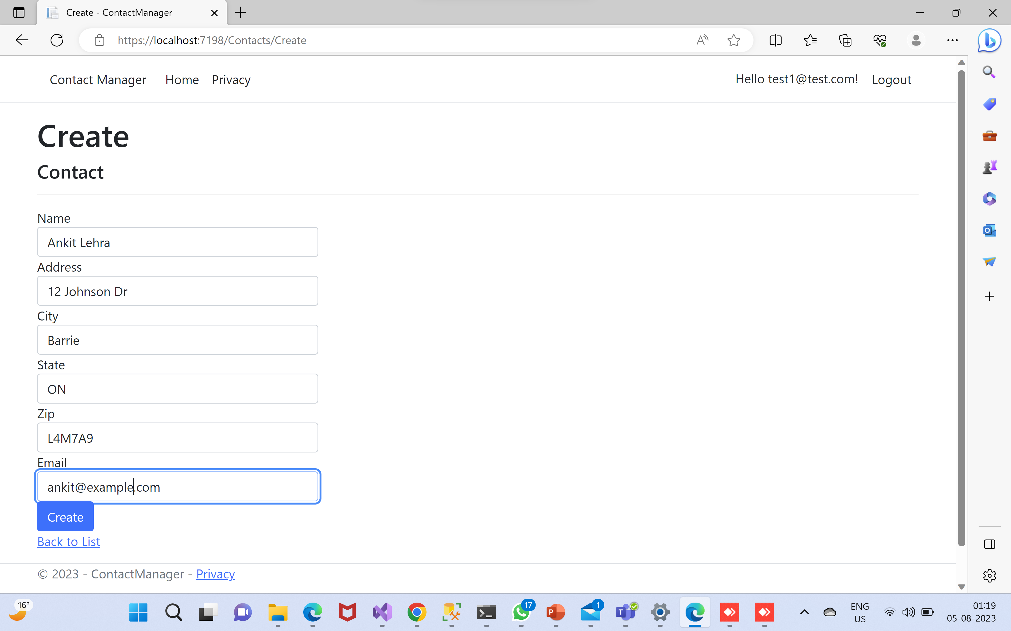
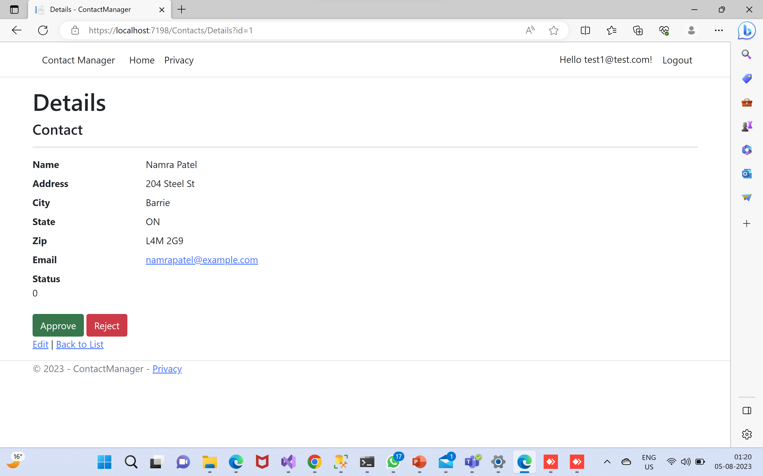
Contact Add/Edit/Delete/View

Slide 20
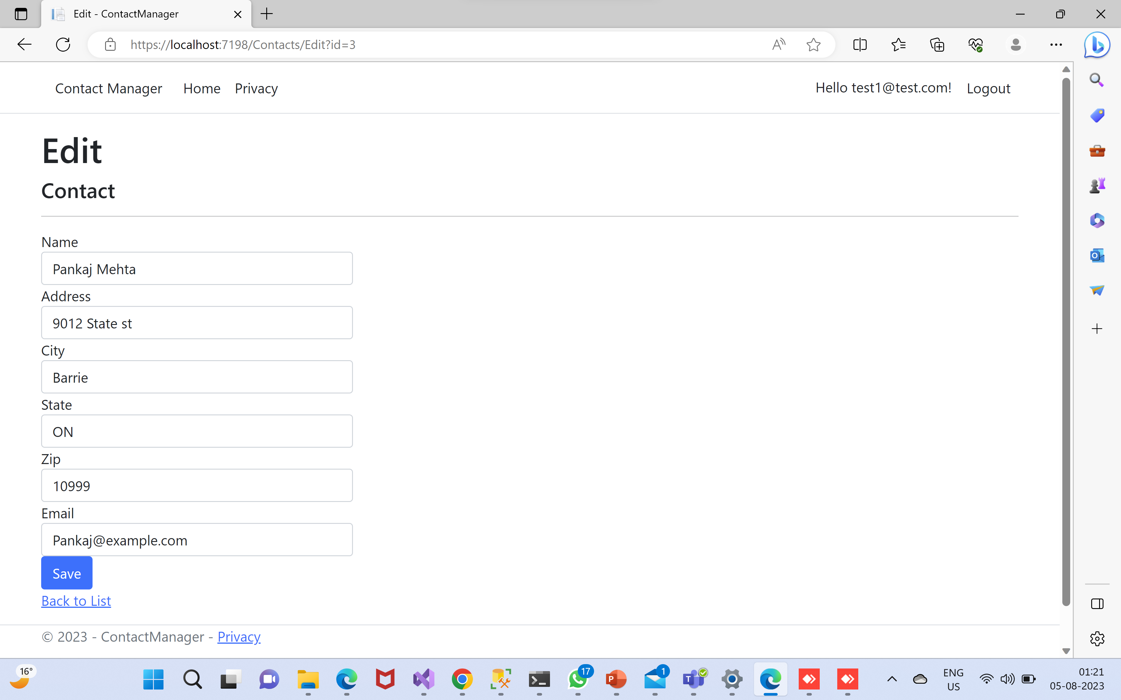
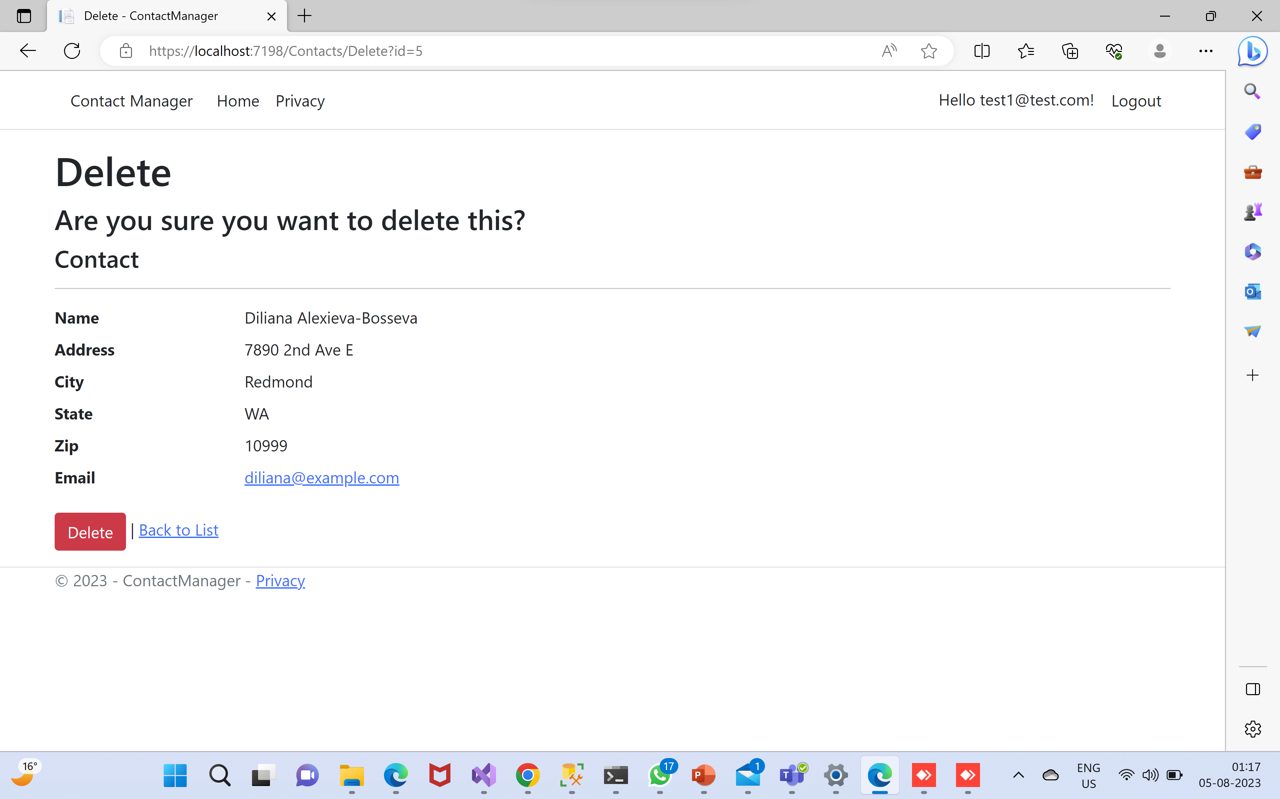
Contact Add/Edit/Delete/View

Slide 21
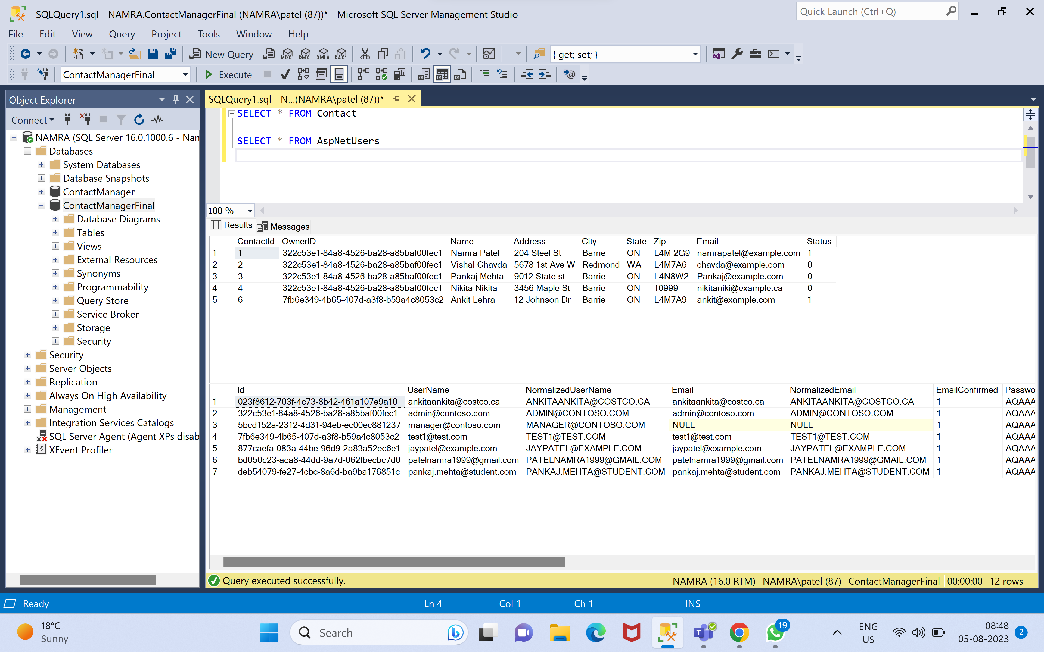
Database
Contact Table
Contains all contact details with their status
Status are as below:
Submitted
Approved
Rejected
AspNetUsers
Contains information of user’s login details, also whether they are confirmed or not

Slide 22

GitHub Link
https://github.com/namra22799/UserAuthentication

Slide 23

THANK YOU !!

